Slide 1
H9DAP – Final Project
Assessing the impact of Electric Vehicles on
CO2 emissions and Air Pollution
By
Brian Riera, Student Number 23186771
Nicholas Stancill, Student Number 22225668
Ramesh Thoppe, Student Number 23206446
National College of Ireland Dublin, Ireland

Slide 2
What we did

Slide 3
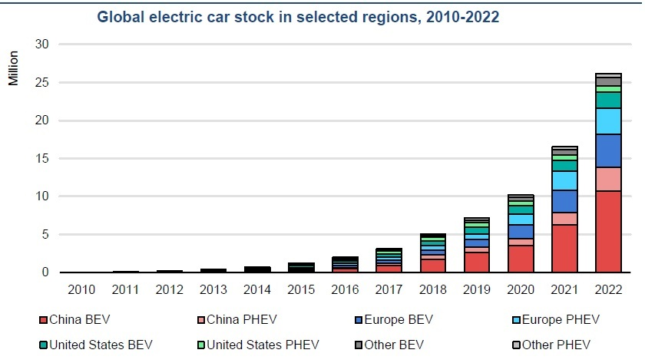

Slide 4
How we did

Slide 5
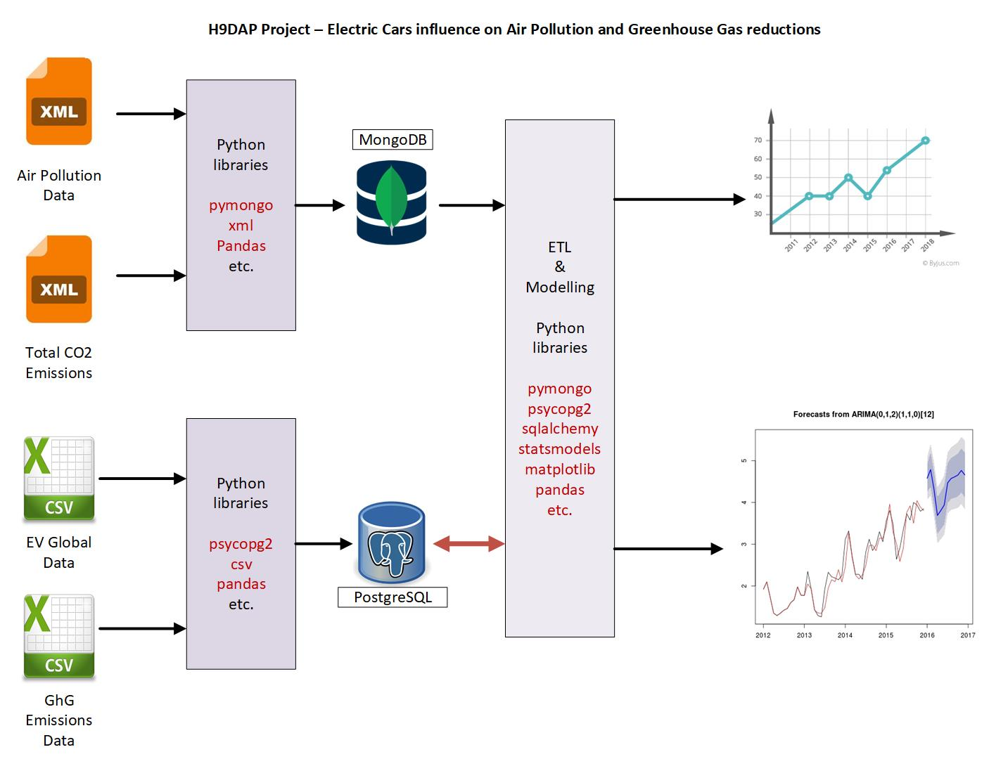
E2E Project solution Design

Slide 6
Why we did
Fossil-fuelled vehicles play a substantial role in the emission of greenhouse gasses (GHGs), accounting for approximately one fifth of global CO2 emissions in 2022
We have a significant role in contributing towards air pollution.
As the global number of vehicles is projected to triple by 2050, associated Greenhouse Gas emissions from Cars are expected to increase at a pace surpassing that of any other emission sources.

Slide 7
What we discovered

Slide 8
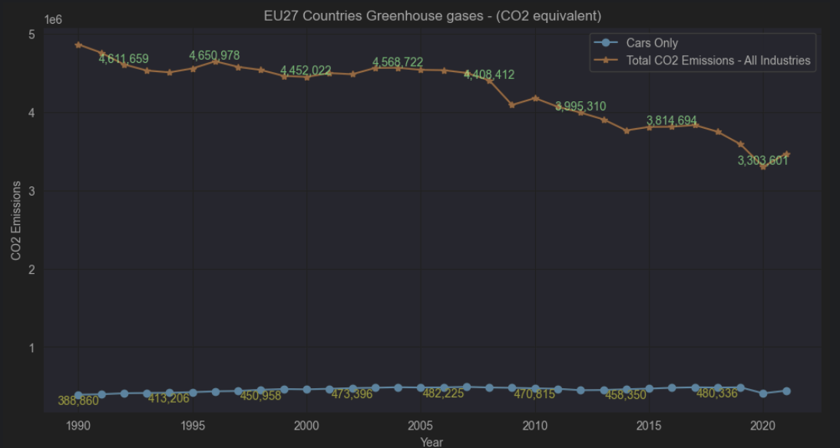
Greenhouse Gas (CO2 equivalent) emissions from all sectors and in particular Cars in 27 Countries of EU

Slide 9
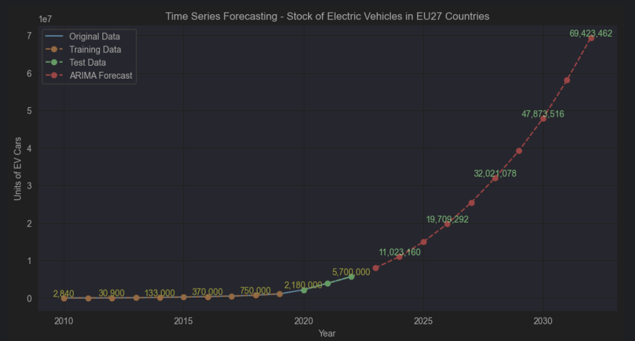
ARIMA Model Forecasting on EV Cars in EU27 Countries

Slide 10
